Slide 1
Chapter 5: Process Synchronization

Slide 2
Chapter 5: Process Synchronization
Background
The Critical-Section Problem
Peterson’s Solution
Synchronization Hardware
Mutex Locks
Semaphores
Classic Problems of Synchronization
Monitors
Synchronization Examples
Alternative Approaches

Slide 3
Objectives
To introduce the critical-section problem, whose solutions can be used to ensure the consistency of shared data
To present both software and hardware solutions of the critical-section problem
To examine several classical process-synchronization problems
To explore several tools that are used to solve process synchronization problems

Slide 4
Background
Processes can execute concurrently
May be interrupted at any time, partially completing execution
Concurrent access to shared data may result in data inconsistency
Maintaining data consistency requires mechanisms to ensure the orderly execution of cooperating processes
Illustration of the problem: Suppose that we wanted to provide a solution to the consumer-producer problem that fills all the buffers. We can do so by having an integer counter that keeps track of the number of full buffers. Initially, counter is set to 0. It is incremented by the producer after it produces a new buffer and is decremented by the consumer after it consumes a buffer.

Slide 5
Race Condition
counter++ could be implemented as register1 = counter register1 = register1 + 1 counter = register1
counter-- could be implemented as register2 = counter register2 = register2 - 1 counter = register2
Consider this execution interleaving with “count = 5” initially:
S0: producer execute register1 = counter {register1 = 5} S1: producer execute register1 = register1 + 1 {register1 = 6} S2: consumer execute register2 = counter {register2 = 5} S3: consumer execute register2 = register2 – 1 {register2 = 4} S4: producer execute counter = register1 {counter = 6 } S5: consumer execute counter = register2 {counter = 4}

Slide 6
Critical Section Problem
Consider system of n processes {p₀, p₁, … p_{n-1}}
Each process has critical section segment of code
Process may be changing common variables, updating table, writing file, etc
When one process in critical section, no other may be in its critical section
Critical section problem is to design protocol to solve this
Each process must ask permission to enter critical section in entry section, may follow critical section with exit section, then remainder section.

Slide 7
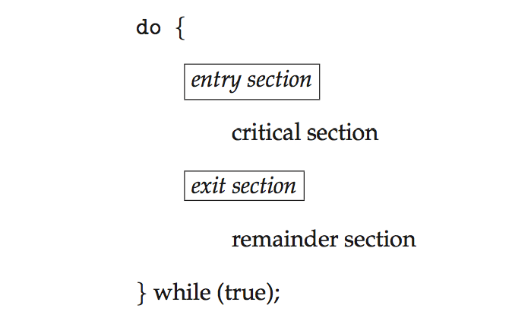
Critical Section
General structure of process p_{i} is

Slide 8
Solution to Critical-Section Problem
1. Mutual Exclusion - If process P_{i} is executing in its critical section, then no other processes can be executing in their critical sections
2. Progress - If no process is executing in its critical section and there exist some processes that wish to enter their critical section, then the selection of the processes that will enter the critical section next cannot be postponed indefinitely
3. Bounded Waiting - A bound must exist on the number of times that other processes are allowed to enter their critical sections after a process has made a request to enter its critical section and before that request is granted
Assume that each process executes at a nonzero speed
No assumption concerning relative speed of the n processes
Two approaches depending on if kernel is preemptive or non-preemptive
Preemptive – allows preemption of process when running in kernel mode
Non-preemptive – runs until exits kernel mode, blocks, or voluntarily yields CPU
Essentially free of race conditions in kernel mode

Slide 9
Peterson’s Solution
Good algorithmic description of solving the problem
Two process solution
Assume that the load and store instructions are atomic; that is, cannot be interrupted
The two processes share two variables:
int turn;
Boolean flag[2]
The variable turn indicates whose turn it is to enter the critical section
The flag array is used to indicate if a process is ready to enter the critical section. flag[i] = true implies that process P_{i} is ready!

Slide 10
Algorithm for Process P_{i}
do {
flag[i] = true;
turn = j;
while (flag[j] && turn == j);
critical section
flag[i] = false;
remainder section
} while (true);
Provable that
Mutual exclusion is preserved
Progress requirement is satisfied
Bounded-waiting requirement is met

Slide 11
QUIZ
Scenario: Time:30min
In a multitasking operating system, the Process control block plays a crucial role in managing processes. Consider a scenario where a computer system is running multiple processesconcurrently. Each process has its own PCB containing essential information about the process.
QUESTION 1:
During the execution of multiple processes, what are some of the key pieces of information stored in its corresponding PCB, and how does the operating system utilize this information to manage the process efficiently?
Provide examples to support your answer.

Slide 12
Question 2:
Describe distributed system and their types and reasons to develop distributed systems?

Slide 13
QUIZ
QUESTION 2:
Consider the following two concurrent processes which share a variable R that is initialize with R=1
P1 P2
for(i=0; i<10 ; i=++) for(j=0; j<8; j++)
R= R+5 R=R+10
What is the maximum possible value of R after completion of both the processes?

Slide 14
Synchronization Hardware
Many systems provide hardware support for critical section code
All solutions below based on idea of locking
Protecting critical regions via locks
Uniprocessors – could disable interrupts
Currently running code would execute without preemption
Generally too inefficient on multiprocessor systems
Operating systems using this not broadly scalable
Modern machines provide special atomic hardware instructions
Atomic = non-interruptible
Either test memory word and set value
Or swap contents of two memory words

Slide 15
Solution to Critical-section Problem Using Locks
do {
acquire lock
critical section
release lock
remainder section
} while (TRUE);
Lock() object provides mutual exclusion,ensures one thread can enter the critical section at a time.
When one thread wants to enter the critical section, it first acquires the lock using mutex.acquire().
If lock is already acquired by another thread , the thread will wait until the lock is released.
Once the critical section is done, the thread releases the lock using mutex.release(), allowing other threads to enter the critical section.

Slide 16
test_and_set Instruction
Definition:
boolean test_and_set (boolean *target)
{
boolean rv = *target;
*target = TRUE;
return rv:
}
test_and_set instruction is a low level atomic operation used in concurrency control mechanism, particularly in solving critical section problem.
Test: It reads the current value of memory location and returns its value.
Set: It sets the value of that memory location to a predetermined value, indicating that the resource is in use or unavailable.
test_and_set operation atomically tests the value of lock variable and set it to 1 if it was previously 0(indicating the lock was acquired). If the previous value was 1 (indicating the lock was already acquired), the thread spins until the lock becomes available.

Slide 17
Solution using test_and_set()
Shared boolean variable lock, initialized to FALSE
Solution:
do { While(Lock==1); Entry while (test_and_set(&lock)) Lock=1 code
; /* do nothing */ Critical Section;
/* critical section */ Lock=0; Exit code
lock = false;
/* remainder section */
} while (true);

Slide 18
compare_and_swap Instruction
This instruction operates on the contents of two words and is executed atomically.
<Definition of compare and <Solution using compare and
swap instruction> swap instruction>
do
{
key=true
Void swap (boolean *a, boolean *b) while (key==true)
{ swap(&lock,&key);
boolean temp; // Critical section
temp=a; lock=false;
*a=*b; }
*b=temp; while(true);
}

Slide 19
Mutex Locks
Previous solutions are complicated and generally inaccessible to application programmers
OS designers build software tools to solve critical section problem
Simplest is mutex lock
Product critical regions with it by first acquire() a lock then release() it
Boolean variable indicating if lock is available or not
Calls to acquire() and release() must be atomic
Usually implemented via hardware atomic instructions
But this solution requires busy waiting
This lock therefore called a spinlock

Slide 20
acquire() and release()
acquire() { while (!available)
; /* busy wait */
available = false;;
}
release() {
available = true;
}
do {
acquire lock
critical section
release lock
remainder section
} while (true);

Slide 21
Semaphore
Synchronization tool that does not require busy waiting
Semaphore S – integer variable
Two standard operations modify S: wait() and signal()
Originally called P() and V()
Less complicated
Can only be accessed via two indivisible (atomic) operations
wait (S) {
while (S <= 0)
; // busy wait
S--;
}
signal (S) {
S++;
}

Slide 22
Semaphore Usage
Counting semaphore – integer value can range over an unrestricted domain
Binary semaphore – integer value can range only between 0 and 1
Then a mutex lock
Can implement a counting semaphore S as a binary semaphore
Can solve various synchronization problems
Consider P₁ and P₂ that require S₁ to happen before S₂
P1:
S₁;
signal(synch);
P2:
wait(synch);
S₂;

Slide 23
Semaphore Implementation
Must guarantee that no two processes can execute wait() and signal() on the same semaphore at the same time
Thus, implementation becomes the critical section problem where the wait and signal code are placed in the critical section
Could now have busy waiting in critical section implementation
But implementation code is short
Little busy waiting if critical section rarely occupied
Note that applications may spend lots of time in critical sections and therefore this is not a good solution

Slide 24
Semaphore Implementation with no Busy waiting
With each semaphore there is an associated waiting queue
Each entry in a waiting queue has two data items:
value (of type integer)
pointer to next record in the list
Two operations:
block – place the process invoking the operation on the appropriate waiting queue
wakeup – remove one of processes in the waiting queue and place it in the ready queue

Slide 25
Semaphore Implementation with no Busy waiting (Cont.)
typedef struct{
int value;
struct process *list;
} semaphore;
wait(semaphore *S) {
S->value--;
if (S->value < 0) { add this process to S->list;
block();
}
}
signal(semaphore *S) {
S->value++;
if (S->value <= 0) { remove a process P from S->list;
wakeup(P);
}
}

Slide 26
Deadlock and Starvation
Deadlock – two or more processes are waiting indefinitely for an event that can be caused by only one of the waiting processes
Let S and Q be two semaphores initialized to 1
P₀ P₁
wait(S); wait(Q);
wait(Q); wait(S);
. .
signal(S); signal(Q);
signal(Q); signal(S);
Starvation – indefinite blocking
A process may never be removed from the semaphore queue in which it is suspended
Priority Inversion – Scheduling problem when lower-priority process holds a lock needed by higher-priority process
Solved via priority-inheritance protocol

Slide 27
Classical Problems of Synchronization
Classical problems used to test newly-proposed synchronization schemes
Bounded-Buffer Problem
Readers and Writers Problem
Dining-Philosophers Problem

Slide 28
Bounded-Buffer Problem
n buffers, each can hold one item
Semaphore mutex initialized to the value 1
Semaphore full initialized to the value 0
Semaphore empty initialized to the value n

Slide 29
Bounded Buffer Problem (Cont.)
The structure of the producer process
do {
... /* produce an item in next_produced */
...
wait(empty);
wait(mutex);
... /* add next produced to the buffer */
...
signal(mutex);
signal(full);
} while (true);

Slide 30
Bounded Buffer Problem (Cont.)
The structure of the consumer process
do {
wait(full);
wait(mutex);
... /* remove an item from buffer to next_consumed */
...
signal(mutex);
signal(empty);
... /* consume the item in next consumed */
... } while (true);

Slide 31
Readers-Writers Problem
A data set is shared among a number of concurrent processes
Readers – only read the data set; they do not perform any updates
Writers – can both read and write
Problem – allow multiple readers to read at the same time
Only one single writer can access the shared data at the same time
Several variations of how readers and writers are treated – all involve priorities
Shared Data
Data set
Semaphore rw_mutex initialized to 1
Semaphore mutex initialized to 1
Integer read_count initialized to 0

Slide 32
Readers-Writers Problem (Cont.)
The structure of a writer process
do { wait(rw_mutex);
... /* writing is performed */
...
signal(rw_mutex);
} while (true);

Slide 33
Readers-Writers Problem (Cont.)
The structure of a reader process
do { wait(mutex); read count++; if (read_count == 1)
wait(rw_mutex);
signal(mutex);
... /* reading is performed */
...
wait(mutex); read count--; if (read_count == 0)
signal(rw_mutex);
signal(mutex);
} while (true);

Slide 34
Readers-Writers Problem Variations
First variation – no reader kept waiting unless writer has permission to use shared object
Second variation – once writer is ready, it performs write ASAP
Both may have starvation leading to even more variations
Problem is solved on some systems by kernel providing reader-writer locks

Slide 35
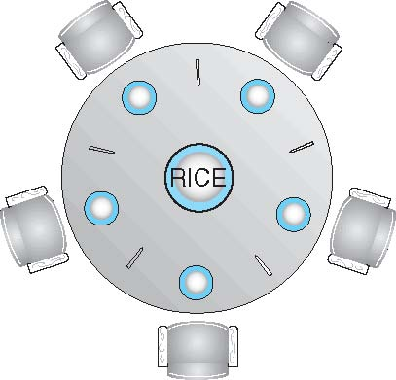
Dining-Philosophers Problem
Philosophers spend their lives thinking and eating
Don’t interact with their neighbors, occasionally try to pick up 2 chopsticks (one at a time) to eat from bowl
Need both to eat, then release both when done
In the case of 5 philosophers
Shared data
Bowl of rice (data set)
Semaphore chopstick [5] initialized to 1

Slide 36
Dining-Philosophers Problem Algorithm
The structure of Philosopher i:
do {
wait (chopstick[i] );
wait (chopStick[ (i + 1) % 5] );
// eat
signal (chopstick[i] );
signal (chopstick[ (i + 1) % 5] );
// think
} while (TRUE);
What is the problem with this algorithm?

Slide 37
Problems with Semaphores
Incorrect use of semaphore operations:
signal (mutex) …. wait (mutex)
wait (mutex) … wait (mutex)
Omitting of wait (mutex) or signal (mutex) (or both)
Deadlock and starvation

Slide 38
Monitors
A high-level abstraction that provides a convenient and effective mechanism for process synchronization
Abstract data type, internal variables only accessible by code within the procedure
Only one process may be active within the monitor at a time
But not powerful enough to model some synchronization schemes
monitor monitor-name
{
// shared variable declarations
procedure P1 (…) { …. }
procedure Pn (…) {……}
Initialization code (…) { … }
}
}

Slide 39
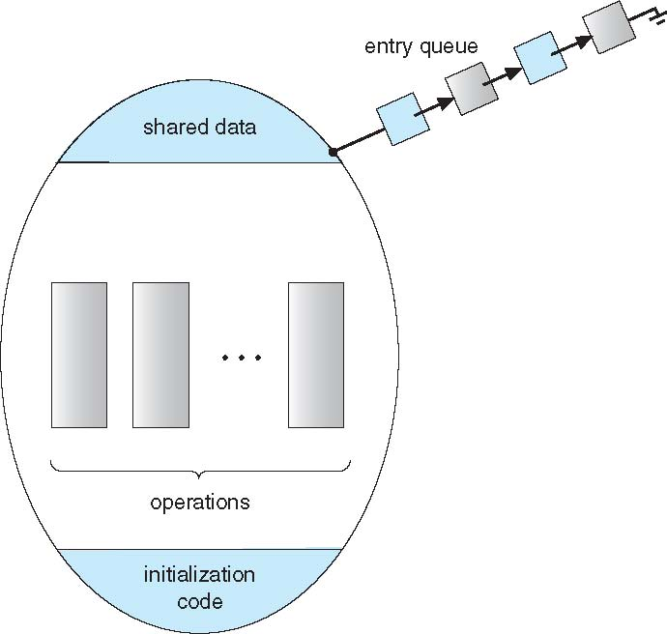
Schematic view of a Monitor

Slide 40
Condition Variables
condition x, y;
Two operations on a condition variable:
x.wait() – a process that invokes the operation is suspended until x.signal()
x.signal() – resumes one of processes (if any) that invoked x.wait()
If no x.wait() on the variable, then it has no effect on the variable

Slide 41
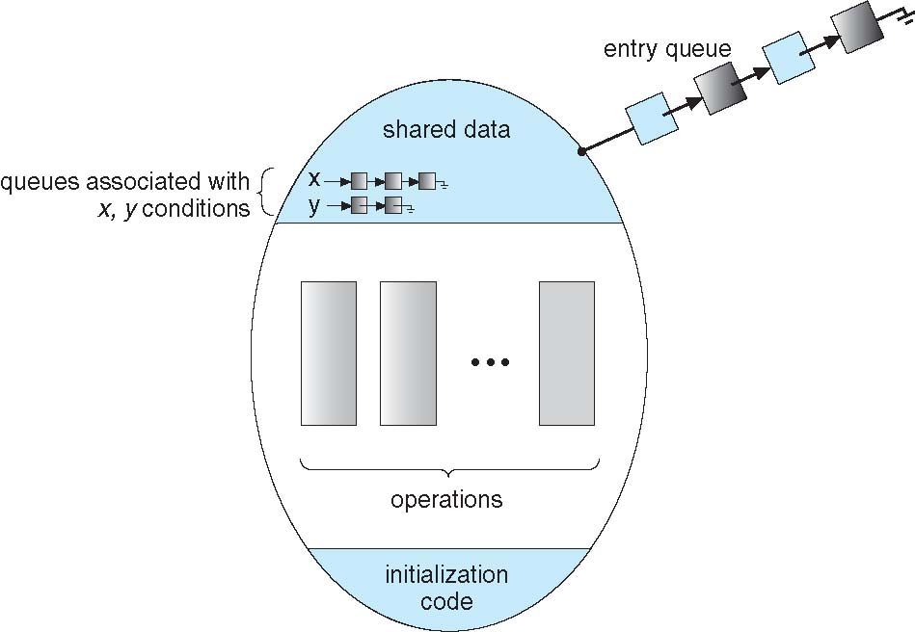
Monitor with Condition Variables

Slide 42
Condition Variables Choices
If process P invokes x.signal(), with Q in x.wait() state, what should happen next?
If Q is resumed, then P must wait
Options include
Signal and wait – P waits until Q leaves monitor or waits for another condition
Signal and continue – Q waits until P leaves the monitor or waits for another condition
Both have pros and cons – language implementer can decide
Monitors implemented in Concurrent Pascal compromise
P executing signal immediately leaves the monitor, Q is resumed
Implemented in other languages including Mesa, C#, Java

Slide 43
Solution to Dining Philosophers
monitor DiningPhilosophers
{
enum { THINKING; HUNGRY, EATING) state [5] ;
condition self [5];
void pickup (int i) {
state[i] = HUNGRY;
test(i);
if (state[i] != EATING) self [i].wait;
}
void putdown (int i) {
state[i] = THINKING;
// test left and right neighbors
test((i + 4) % 5);
test((i + 1) % 5);
}

Slide 44
Solution to Dining Philosophers (Cont.)
void test (int i) {
if ( (state[(i + 4) % 5] != EATING) &&
(state[i] == HUNGRY) &&
(state[(i + 1) % 5] != EATING) ) {
state[i] = EATING ;
self[i].signal () ;
}
}
initialization_code() {
for (int i = 0; i < 5; i++)
state[i] = THINKING;
}
}

Slide 45
Solution to Dining Philosophers (Cont.)
Each philosopher i invokes the operations pickup() and putdown() in the following sequence:
DiningPhilosophers.pickup(i);
EAT
DiningPhilosophers.putdown(i);
No deadlock, but starvation is possible

Slide 46
Monitor Implementation Using Semaphores
Variables
semaphore mutex; // (initially = 1)
semaphore next; // (initially = 0)
int next_count = 0;
Each procedure F will be replaced by
wait(mutex);
…
body of F;
…
if (next_count > 0)
signal(next)
else
signal(mutex);
Mutual exclusion within a monitor is ensured

Slide 47
Monitor Implementation – Condition Variables
For each condition variable x, we have:
semaphore x_sem; // (initially = 0)
int x_count = 0;
The operation x.wait can be implemented as:
x_count++;
if (next_count > 0)
signal(next);
else
signal(mutex);
wait(x_sem);
x_count--;

Slide 48
Monitor Implementation (Cont.)
The operation x.signal can be implemented as:
if (x_count > 0) {
next_count++;
signal(x_sem);
wait(next);
next_count--;
}

Slide 49
Resuming Processes within a Monitor
If several processes queued on condition x, and x.signal() executed, which should be resumed?
FCFS frequently not adequate
conditional-wait construct of the form x.wait(c)
Where c is priority number
Process with lowest number (highest priority) is scheduled next

Slide 50
A Monitor to Allocate Single Resource
monitor ResourceAllocator
{
boolean busy;
condition x;
void acquire(int time) {
if (busy)
x.wait(time);
busy = TRUE;
}
void release() {
busy = FALSE;
x.signal();
}
initialization code() {
busy = FALSE;
}
}

Slide 51
Synchronization Examples
Solaris
Windows XP
Linux
Pthreads

Slide 52
Solaris Synchronization
Implements a variety of locks to support multitasking, multithreading (including real-time threads), and multiprocessing
Uses adaptive mutexes for efficiency when protecting data from short code segments
Starts as a standard semaphore spin-lock
If lock held, and by a thread running on another CPU, spins
If lock held by non-run-state thread, block and sleep waiting for signal of lock being released
Uses condition variables
Uses readers-writers locks when longer sections of code need access to data
Uses turnstiles to order the list of threads waiting to acquire either an adaptive mutex or reader-writer lock
Turnstiles are per-lock-holding-thread, not per-object
Priority-inheritance per-turnstile gives the running thread the highest of the priorities of the threads in its turnstile

Slide 53
Windows XP Synchronization
Uses interrupt masks to protect access to global resources on uniprocessor systems
Uses spinlocks on multiprocessor systems
Spinlocking-thread will never be preempted
Also provides dispatcher objects user-land which may act mutexes, semaphores, events, and timers
Events
An event acts much like a condition variable
Timers notify one or more thread when time expired
Dispatcher objects either signaled-state (object available) or non-signaled state (thread will block)

Slide 54
Linux Synchronization
Linux:
Prior to kernel Version 2.6, disables interrupts to implement short critical sections
Version 2.6 and later, fully preemptive
Linux provides:
semaphores
spinlocks
reader-writer versions of both
On single-cpu system, spinlocks replaced by enabling and disabling kernel preemption

Slide 55
Pthreads Synchronization
Pthreads API is OS-independent
It provides:
mutex locks
condition variables
Non-portable extensions include:
read-write locks
spinlocks

Slide 56
Atomic Transactions
System Model
Log-based Recovery
Checkpoints
Concurrent Atomic Transactions

Slide 57
System Model
Assures that operations happen as a single logical unit of work, in its entirety, or not at all
Related to field of database systems
Challenge is assuring atomicity despite computer system failures
Transaction - collection of instructions or operations that performs single logical function
Here we are concerned with changes to stable storage – disk
Transaction is series of read and write operations
Terminated by commit (transaction successful) or abort (transaction failed) operation
Aborted transaction must be rolled back to undo any changes it performed

Slide 58
Types of Storage Media
Volatile storage – information stored here does not survive system crashes
Example: main memory, cache
Nonvolatile storage – Information usually survives crashes
Example: disk and tape
Stable storage – Information never lost
Not actually possible, so approximated via replication or RAID to devices with independent failure modes
Goal is to assure transaction atomicity where failures cause loss of information on volatile storage

Slide 59
Log-Based Recovery
Record to stable storage information about all modifications by a transaction
Most common is write-ahead logging
Log on stable storage, each log record describes single transaction write operation, including
Transaction name
Data item name
Old value
New value
<T_{i} starts> written to log when transaction T_{i} starts
<T_{i} commits> written when T_{i} commits
Log entry must reach stable storage before operation on data occurs

Slide 60
Log-Based Recovery Algorithm
Using the log, system can handle any volatile memory errors
Undo(T_{i}) restores value of all data updated by T_{i}
Redo(T_{i}) sets values of all data in transaction T_{i} to new values
Undo(T_{i}) and redo(T_{i}) must be idempotent
Multiple executions must have the same result as one execution
If system fails, restore state of all updated data via log
If log contains <T_{i} starts> without <T_{i} commits>, undo(T_{i})
If log contains <T_{i} starts> and <T_{i} commits>, redo(T_{i})

Slide 61
Checkpoints
Log could become long, and recovery could take long
Checkpoints shorten log and recovery time.
Checkpoint scheme:
Output all log records currently in volatile storage to stable storage
Output all modified data from volatile to stable storage
Output a log record <checkpoint> to the log on stable storage
Now recovery only includes Ti, such that Ti started executing before the most recent checkpoint, and all transactions after Ti All other transactions already on stable storage

Slide 62
Concurrent Transactions
Must be equivalent to serial execution – serializability
Could perform all transactions in critical section
Inefficient, too restrictive
Concurrency-control algorithms provide serializability

Slide 63
Serializability
Consider two data items A and B
Consider Transactions T₀ and T₁
Execute T₀, T₁ atomically
Execution sequence called schedule
Atomically executed transaction order called serial schedule
For N transactions, there are N! valid serial schedules

Slide 64
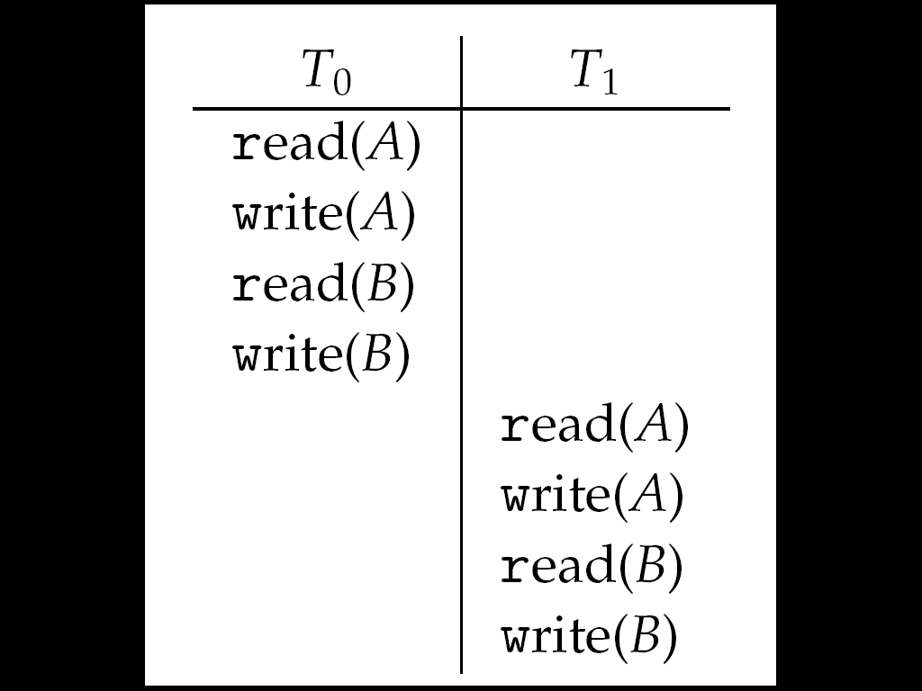
Schedule 1: T₀ then T₁

Slide 65
Nonserial Schedule
Nonserial schedule allows overlapped execute
Resulting execution not necessarily incorrect
Consider schedule S, operations O_{i}, O_{j}
Conflict if access same data item, with at least one write
If O_{i}, O_{j} consecutive and operations of different transactions & O_{i} and O_{j} don’t conflict
Then S’ with swapped order O_{j} O_{i} equivalent to S
If S can become S’ via swapping nonconflicting operations
S is conflict serializable

Slide 66
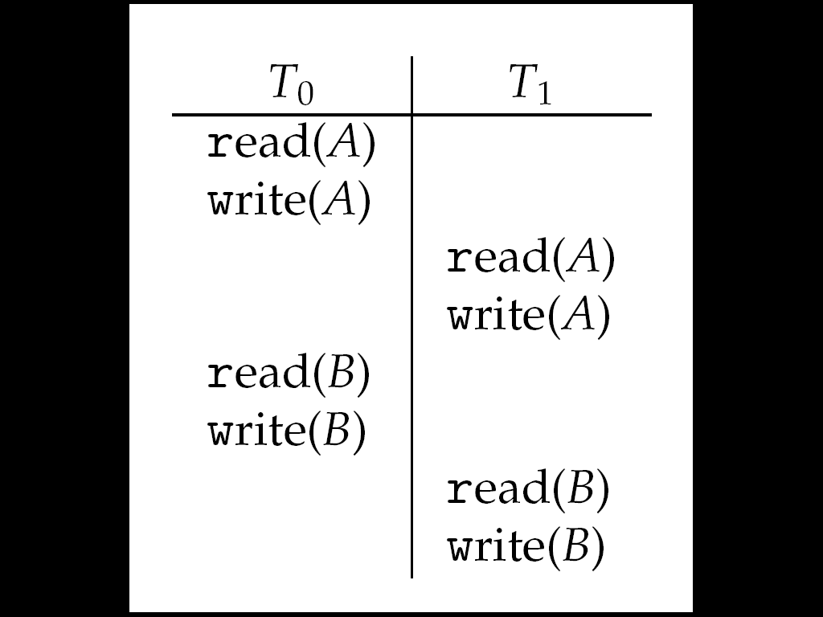
Schedule 2: Concurrent Serializable Schedule

Slide 67
Locking Protocol
Ensure serializability by associating lock with each data item
Follow locking protocol for access control
Locks
Shared – T_{i} has shared-mode lock (S) on item Q, T_{i} can read Q but not write Q
Exclusive – Ti has exclusive-mode lock (X) on Q, T_{i} can read and write Q
Require every transaction on item Q acquire appropriate lock
If lock already held, new request may have to wait
Similar to readers-writers algorithm

Slide 68
Two-phase Locking Protocol
Generally ensures conflict serializability
Each transaction issues lock and unlock requests in two phases
Growing – obtaining locks
Shrinking – releasing locks
Does not prevent deadlock

Slide 69
Timestamp-based Protocols
Select order among transactions in advance – timestamp-ordering
Transaction T_{i} associated with timestamp TS(T_{i}) before T_{i} starts
TS(T_{i}) < TS(T_{j}) if Ti entered system before T_{j}
TS can be generated from system clock or as logical counter incremented at each entry of transaction
Timestamps determine serializability order
If TS(T_{i}) < TS(T_{j}), system must ensure produced schedule equivalent to serial schedule where T_{i} appears before T_{j}

Slide 70
Timestamp-based Protocol Implementation
Data item Q gets two timestamps
W-timestamp(Q) – largest timestamp of any transaction that executed write(Q) successfully
R-timestamp(Q) – largest timestamp of successful read(Q)
Updated whenever read(Q) or write(Q) executed
Timestamp-ordering protocol assures any conflicting read and write executed in timestamp order
Suppose Ti executes read(Q)
If TS(T_{i}) < W-timestamp(Q), Ti needs to read value of Q that was already overwritten
read operation rejected and T_{i} rolled back
If TS(T_{i}) ≥ W-timestamp(Q)
read executed, R-timestamp(Q) set to max(R-timestamp(Q), TS(T_{i}))

Slide 71
Timestamp-ordering Protocol
Suppose Ti executes write(Q)
If TS(T_{i}) < R-timestamp(Q), value Q produced by T_{i} was needed previously and T_{i} assumed it would never be produced
Write operation rejected, T_{i} rolled back
If TS(T_{i}) < W-timestamp(Q), T_{i} attempting to write obsolete value of Q
Write operation rejected and T_{i} rolled back
Otherwise, write executed
Any rolled back transaction T_{i} is assigned new timestamp and restarted
Algorithm ensures conflict serializability and freedom from deadlock

Slide 72
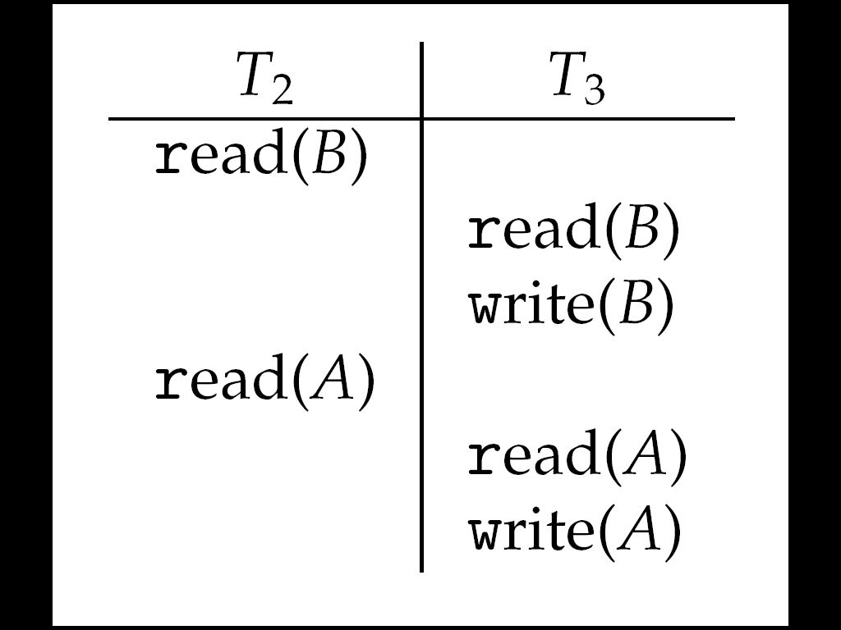
Schedule Possible Under Timestamp Protocol

Slide 73
End of Chapter 5

